Slide 1
AMTRAK Public Hearing on Train Accessibility
August 30, 2023

Slide 2
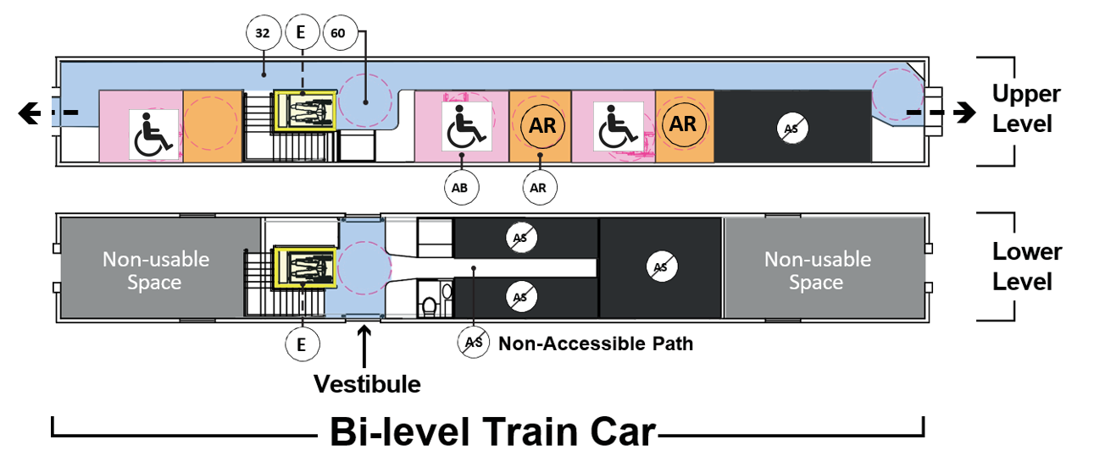
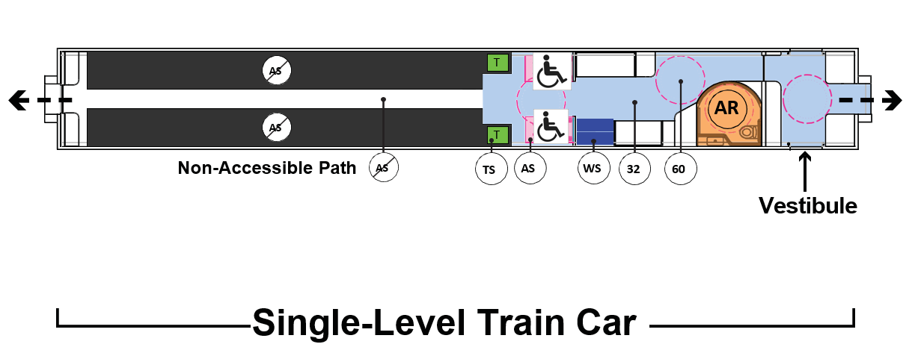
The below color coding and marking system is used on the following preliminary design concept layouts to clearly identify the accessible features of the train design
Legend
Accessible Space: Space for a person who wishes to remain their wheelchair or mobility device
Accessible Bedroom: Bedroom with an en-suite accessible restroom with turning space
Accessible Restroom: Restroom with turning space and space to side transfer onto the toilet
Elevator: Available for passengers who use wheelchairs or who cannot use the stairs
32” Accessible Path: 32” aisle width for passengers who use wheelchairs to access other areas of the train
60” Turning Space: 60” diameter circular turning space for passengers who use a wheelchair to turn around
Transfer Seat: Seat for those who transfer from a wheelchair to a seat
Wheel Mobility Device Storage Space: Space reserved for those wishing to store a folded wheelchair or other foldable mobility aids
Non-Accessible Seating, Rooms, or Crew Areas: Non-accessible aisles, seating areas, diner and lounge seating, private rooms, and/or crew rooms
AR
Example Car Diagrams
AR

Slide 3
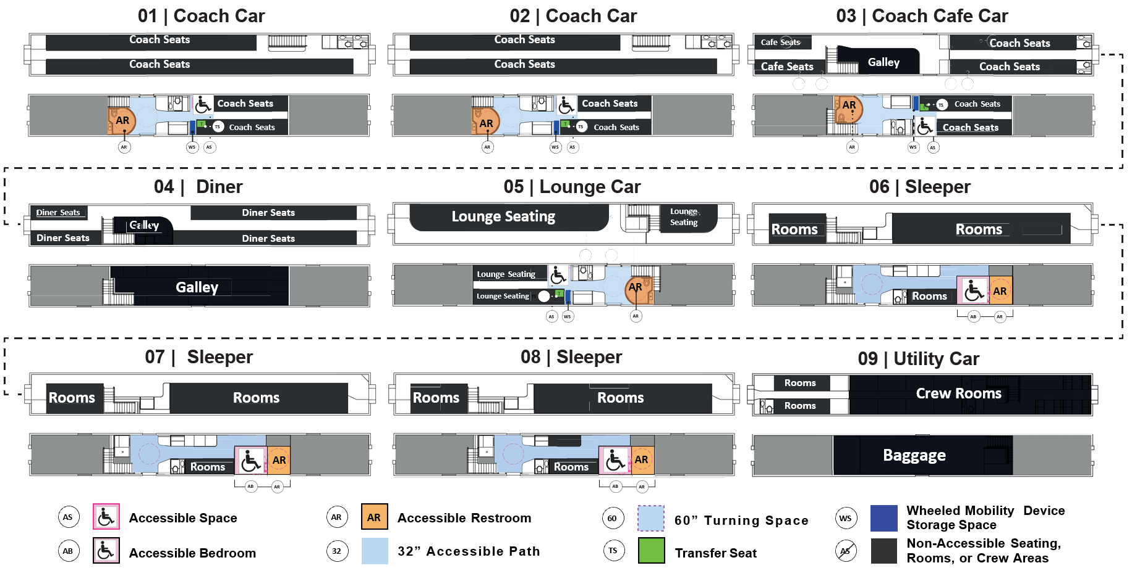
ADA Concept Design

Slide 4
Alternative Design Standards
Accessible Core Trainset
Enhanced mobility between cars, semi permanent coupling.
2. Number of Accommodations
Number of accessible coach/bedroom spaces in a trainset equal to or greater than the number of coach/sleeper cars in the trainset.
3. Access to Amenities
All accessible spaces within an accessible core area of the trainset, with access to amenities, via accessible 32” wide path.
4. Priority Positions
Accessible sleeper and coach cars will have priority over any non-accessible sleeper and coach cars in terms of proximity to dining and lounge cars.
5. Access to Redundant Restrooms
All accessible spaces will have access to at least two accessible restrooms, via an accessible 32” wide path.
6. Access to Redundant Vertical Access Points
All accessible coach spaces and accessible bedrooms on the upper level of a bi-level train will have access, via an accessible 32” wide path, to at least two accessible elevators for boarding and deboarding.

Slide 5
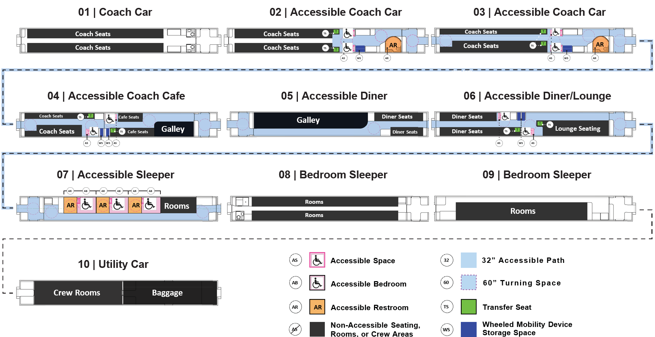
Single-Level Trainset Arrangement Preliminary Equivalent Facilitation Concept Design

Slide 6
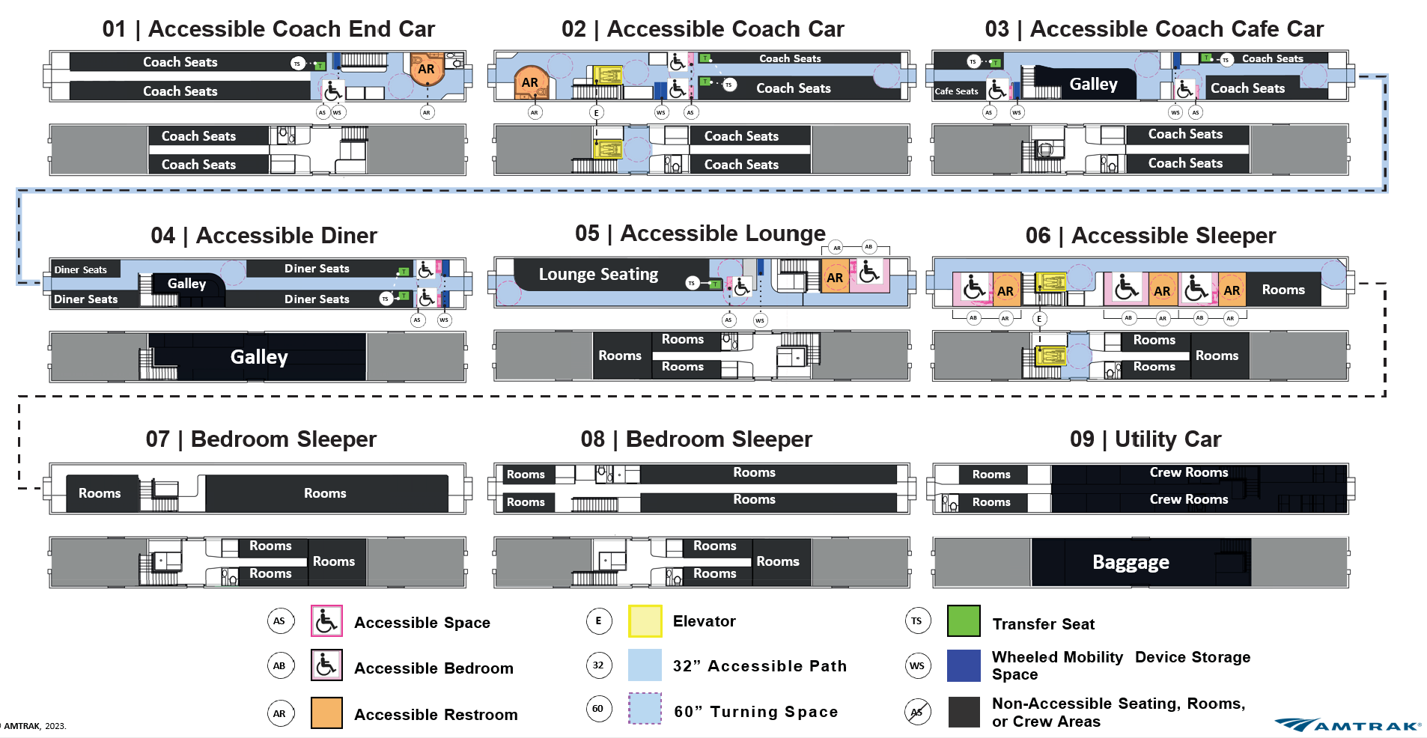
Bi-Level Trainset Arrangement Preliminary Equivalent Facilitation Concept Design

Slide 7
Thank You!
August 30, 2023

